Slide 1
Presidential election campaign finances
Dan Edie, Megan Chang, & Nicholas Prentkowski

Slide 2
introduction
Initial questions
sources
How much are candidates spending on elections?
Are the most populous states contributing the most money?
Federal Election Commission's API
Pull data on campaign receipts
MIT's Election Lab database
Number of votes each candidate received

Slide 3
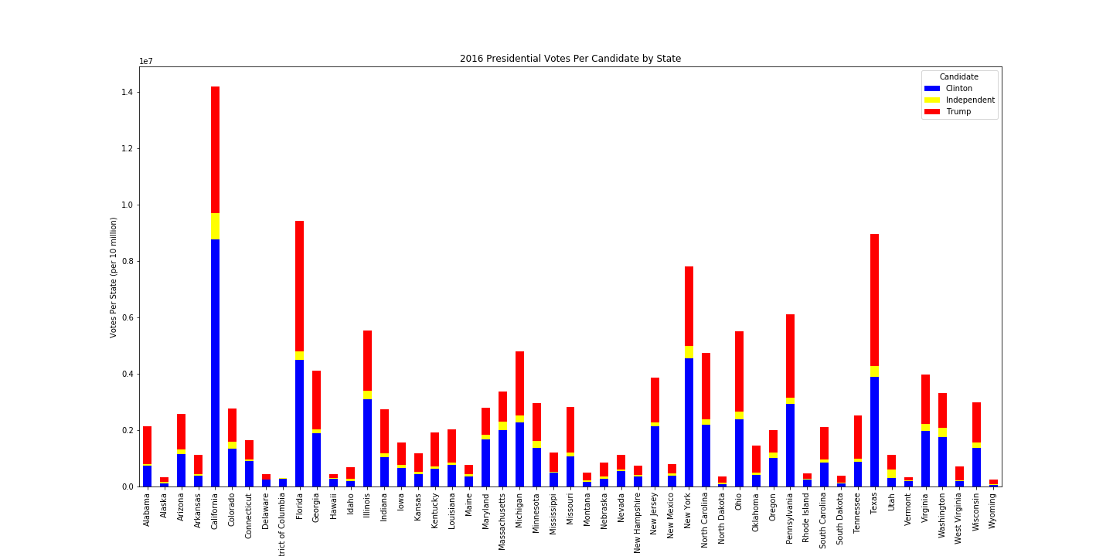

Slide 6
Net receipts presidential candidates 2020

Slide 7
Total reciepts

